Slide 1


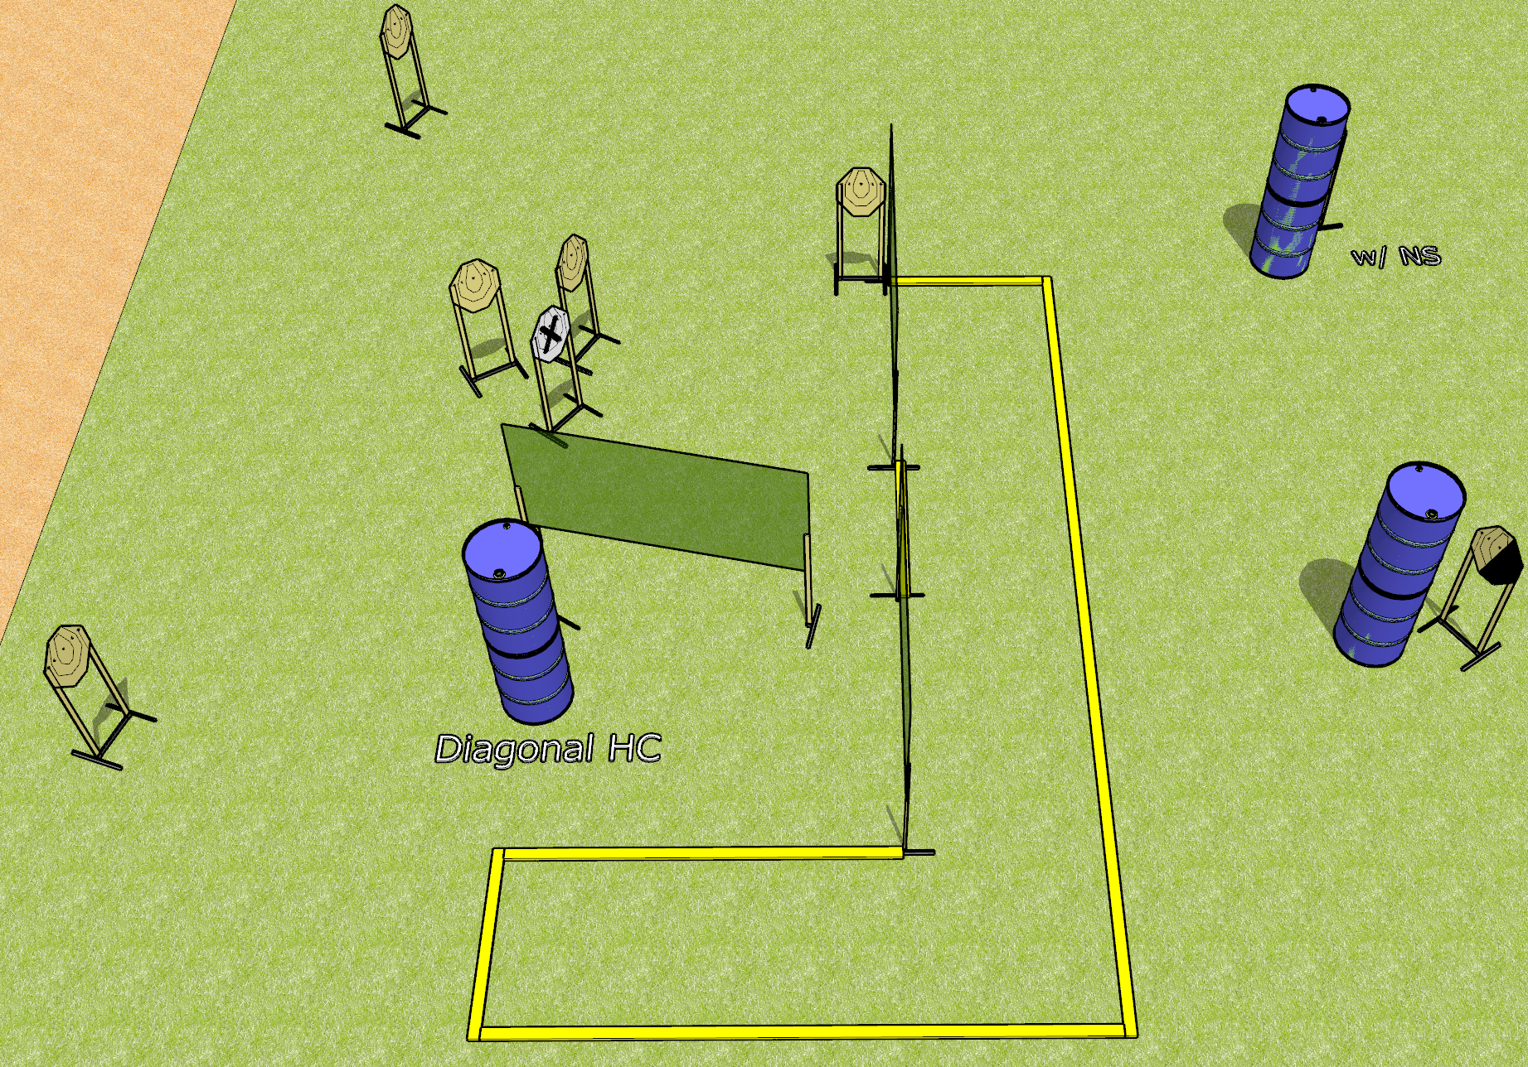
 | Dothan Gun Club – USPSA Match Easy Course Designer : Drew Coleman
Round Count 16 rounds 8 IPSC
Equipment List 6 wall feet 2 medium fault lines 2 diagonal hard cover

Slide 2
Easy
Written Stage Briefing
Easy is a 16 round, 80 point, Comstock course of fire. There are 8 IPSC targets. The best 2 hits on paper will score. The start signal is audible.
Handgun start position is anywhere inside the shooting area, wrists below belt. Handgun is loaded and holstered.
PCC start position is anywhere inside the shooting area, stock on belt. Loaded carbine is held with both hands, safety on.
On start signal, engage targets as they become available from within the shooting area.

